Slide 1
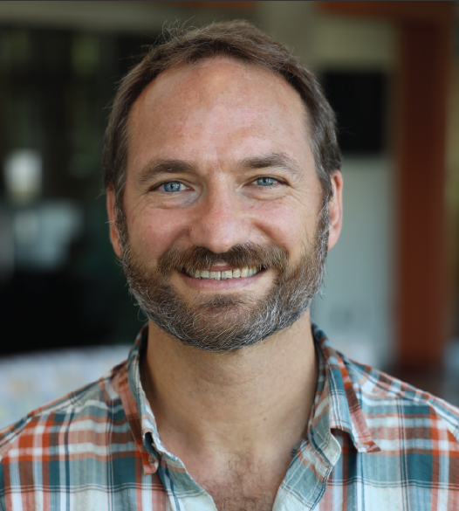
Geology & Environmental Science
University of Pittsburgh
Spring 2024
Colloquium Series
BROXTON BIRD, Ph.D.
Department of Earth and Environmental Sciences Indiana University
Late Holocene Climate-flood Relationships in the Midcontinental United States
Floods are the most frequent type of natural disaster and among the costliest. In the Midwestern United states, increases in the frequency, magnitude, and duration of floods on rivers of all sizes has been attributed to increases in average annual precipitation and more frequent extreme precipitation events as a result of climate change. But these trends are occurring within a fundamentally altered landscape, which makes it difficult to determine whether these trends reflect “natural” climate-flood relationships or a new normal. Longterm flood records that capture climate-flood dynamics prior to Euro-American settlement in the 1700s are therefore needed to distinguish “natural” from anthropogenic climateflood dynamics. In this presentation, I will discuss the progress that has been made in characterizing natural and anthropogenic climate-flood relationships during the late Holocene (last ca. 4000 years) through the development flood records from floodplain lake sediment archives that represent a range of watershed sizes in midcontinental North America. Synthesis of these new flood records with existing paleoclimate data reveals that flooding prior to Euro-American settlement was dependent on a stream’s watershed size. Specifically, medium to small streams (Stahler stream orders 7 and less) were sensitive to the frequency of rainstorm events typical of warm-season-like conditions while flooding on large streams (Stahler stream orders 8 and higher) reflected changes in cold-season snowpack. The modern trend toward increased flooding on streams of all sizes is a departure from “natural” climate-flood dynamics and is attributed to increased runoff as a consequence of anthropogenic land use. Predicted increases in average annual precipitation and extreme precipitation events are therefore likely to further increase the frequency, duration, and magnitude of floods in the midcontinental US.
Bagels, donuts, and coffee available in SRCC 219 before the talk!
April 4, 2024
Thaw 104 @ 4:00PM

