Slide 1
Pitt Experiences in Wyoming:
GEOL 1930: Yellowstone Field Class
https://www.abroad.pitt.edu/yellowstone

Slide 2
Two Offerings in Wyoming
Map with stars
Yellowstone Field Course: Ranges over a large area around Yellowstone National Park, from Cody WY to Red Lodge MT to the Tetons National Park.

Slide 3
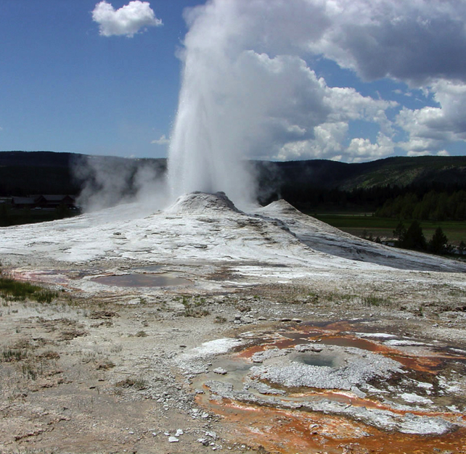
The Yellowstone Field Course
Purpose: To give a thorough understanding of the environment, ecology, and economy in an area where all three are obviously dependent on regional geology.
The month-long class is broken into three parts:
Geology
Biology/ecology
Public policy
Sawmill Geyser

Slide 4
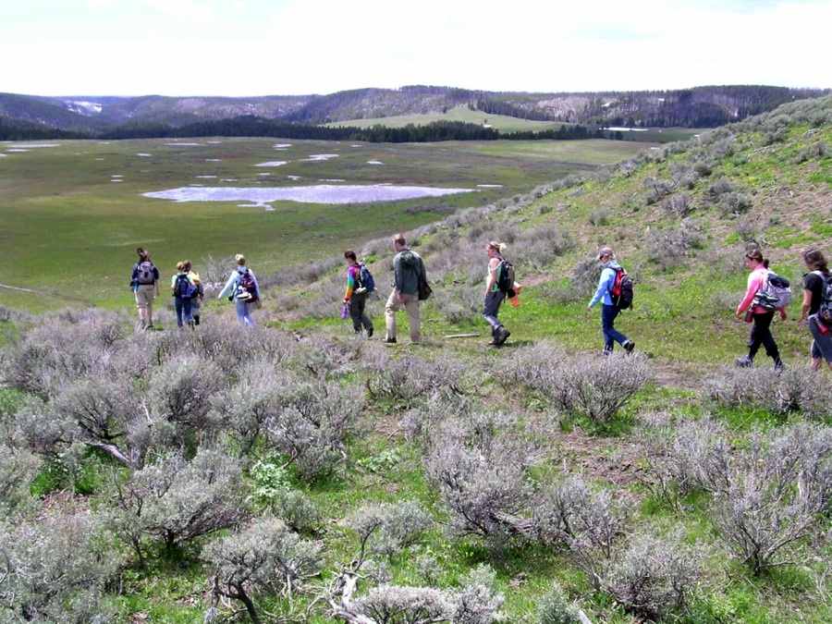
Yellowstone Field Course
Virtually all instruction and some of the exams take place in the wilderness. Almost every day is spent hiking!

Slide 5
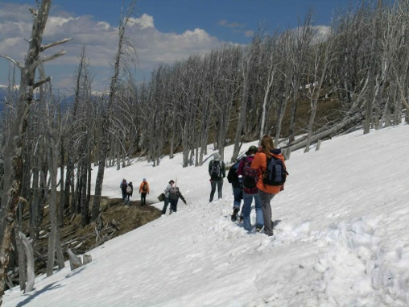
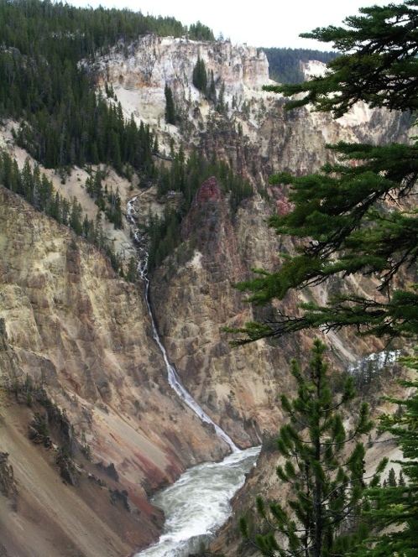
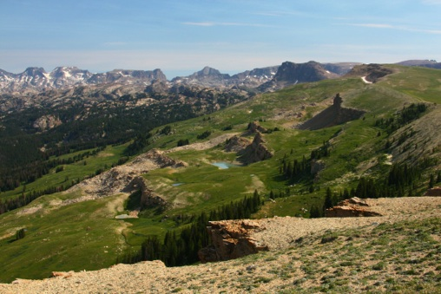
Yellowstone
Hike to beautiful places

Slide 6
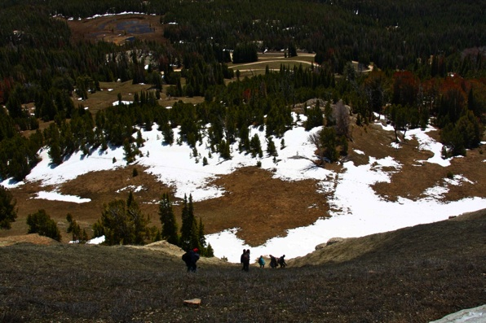
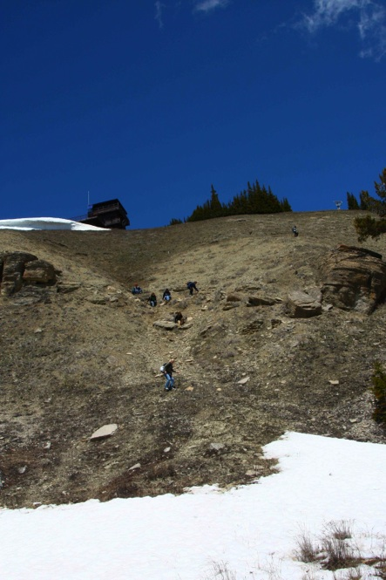

Slide 7
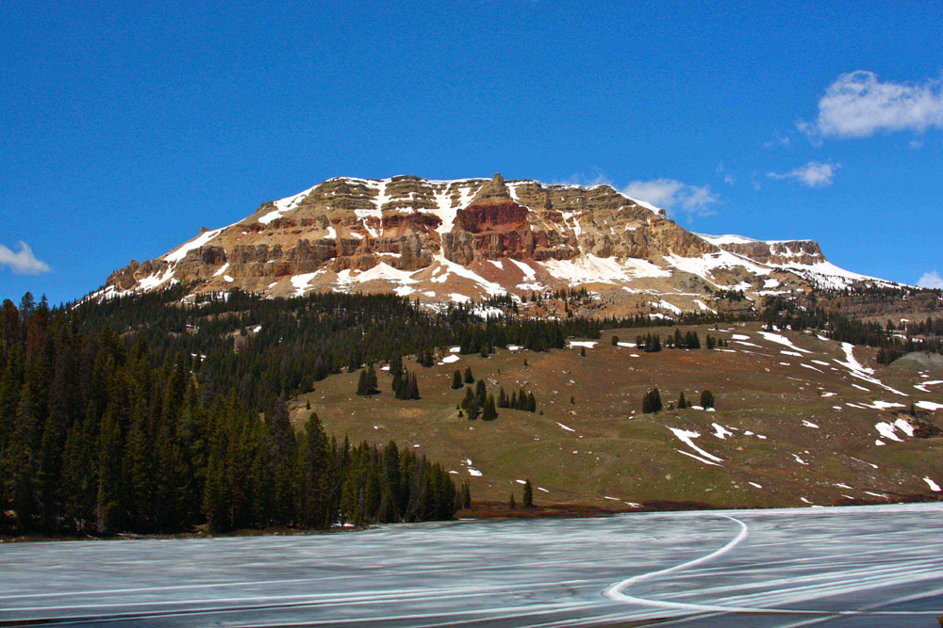
Yellowstone
Geology section covers the ~2.7 billion years of history exposed from Yellowstone to Red Lodge, MT, and Cody, WY.

Slide 8
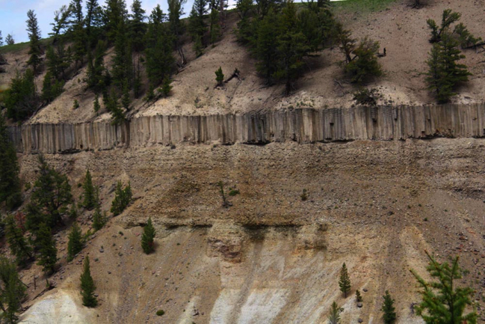
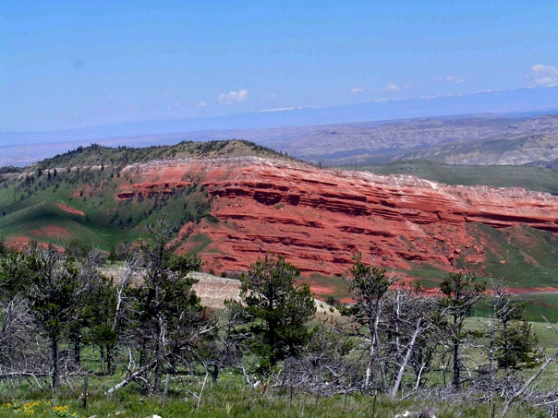
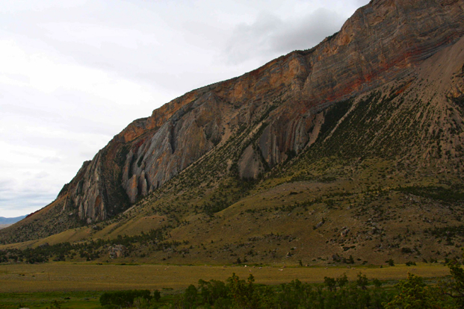
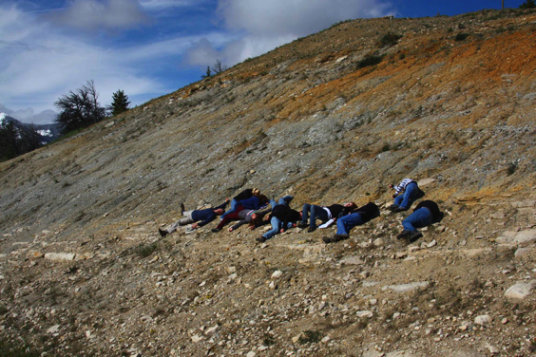
Greater Yellowstone Area
Lots of geology!

Slide 9
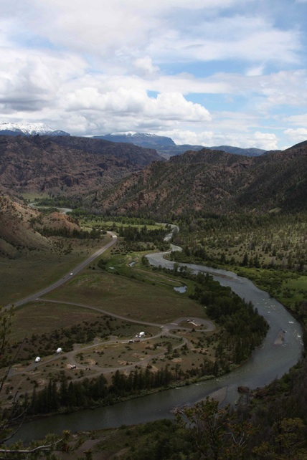
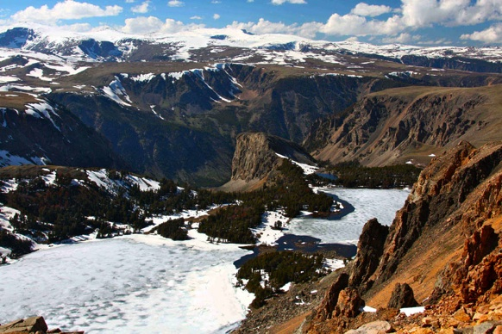
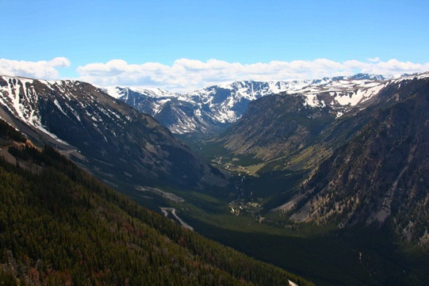
Yellowstone
Lots of hiking!

Slide 10
Yellowstone National Park

Slide 11
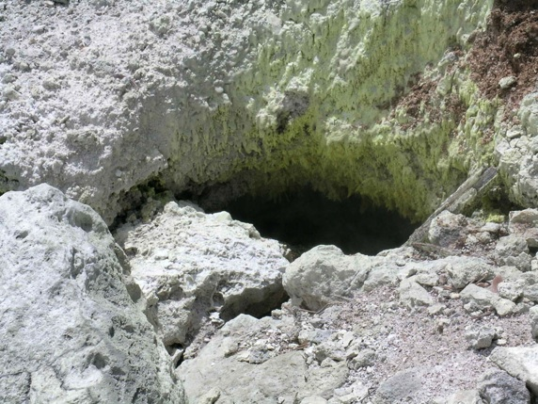
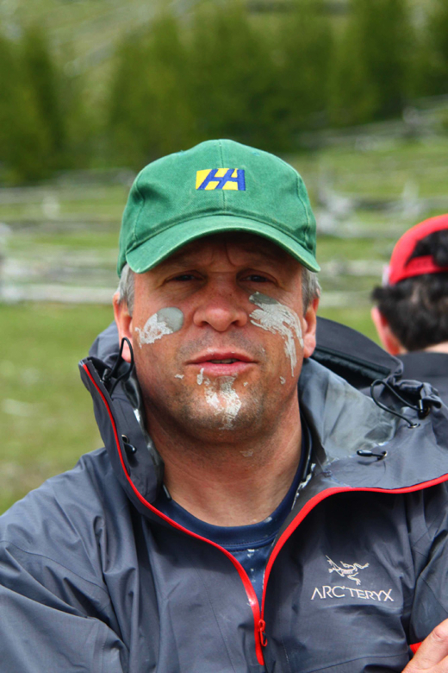
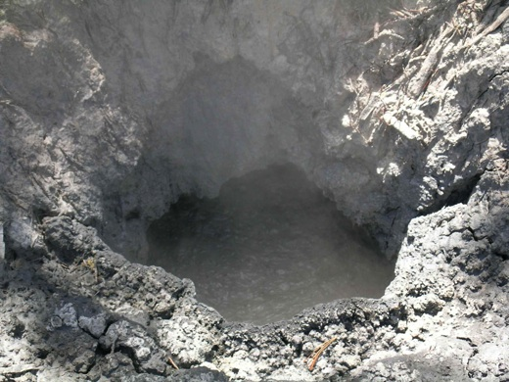
Yellowstone
Lots of hiking!

Slide 12
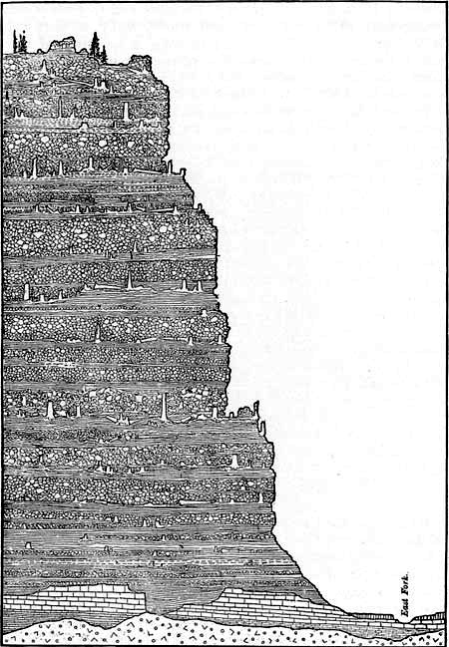
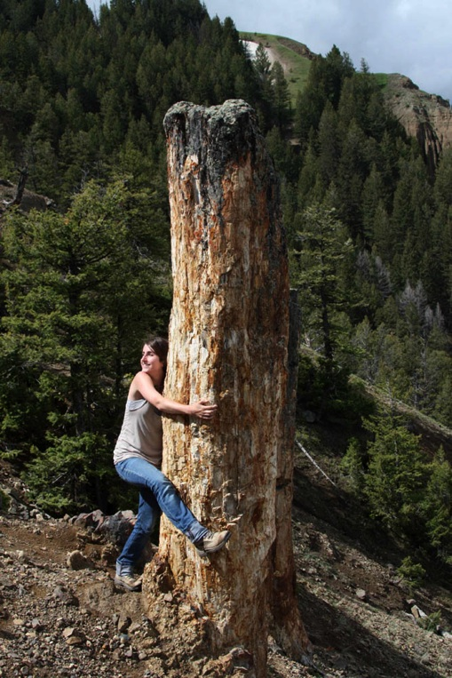
Something like 47 fossil forests are preserved in the 50-Myr-old volcanics in the park.

Slide 13
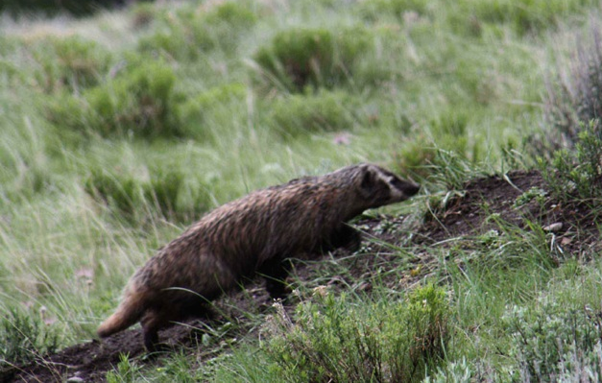
Biology section: Lots of Wildlife

Slide 14
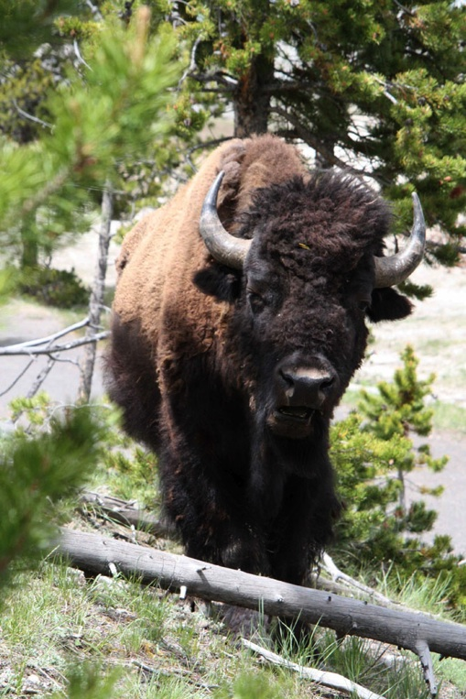

Slide 15
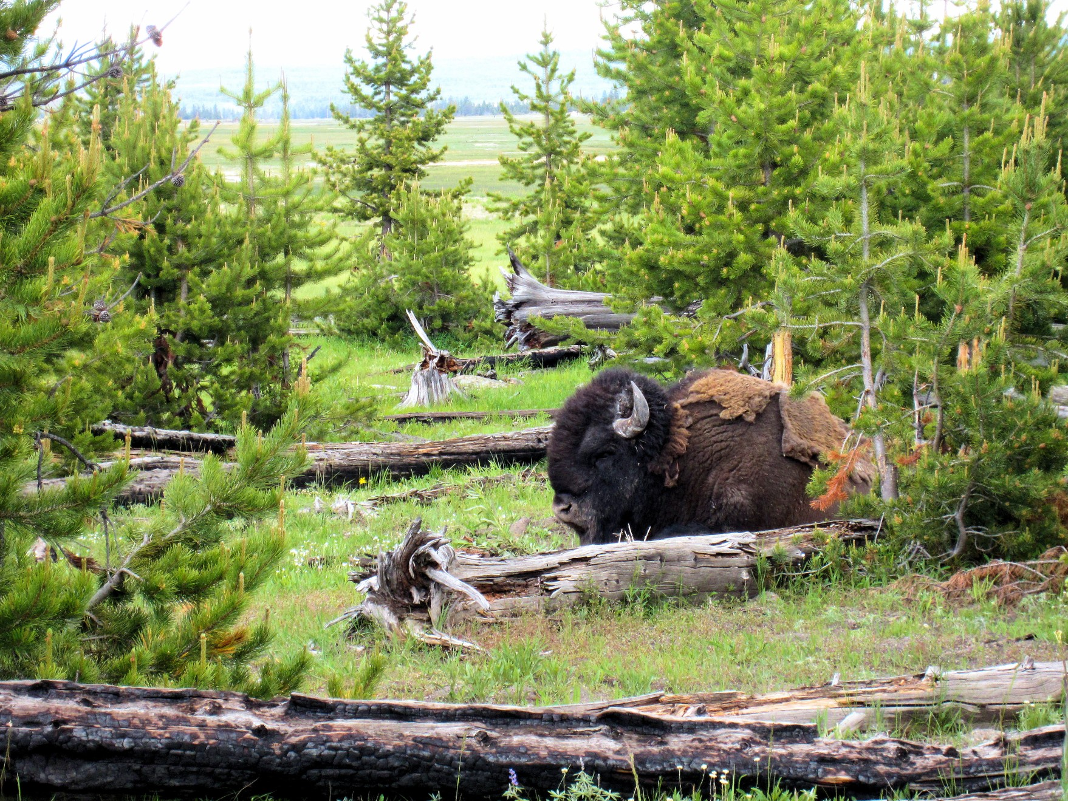

Slide 16
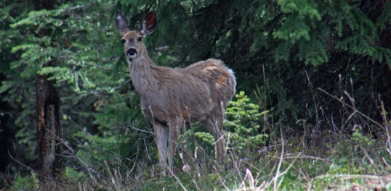
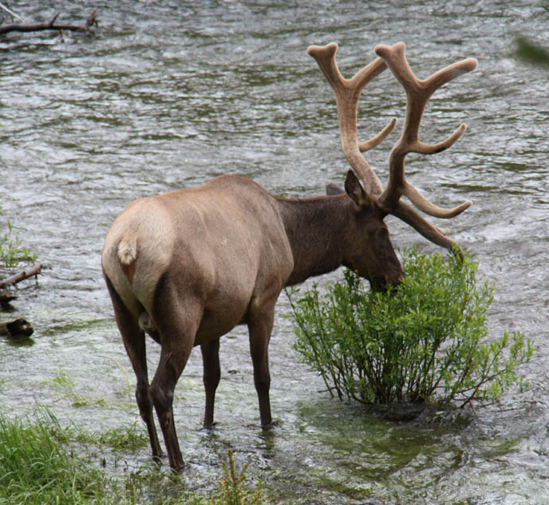
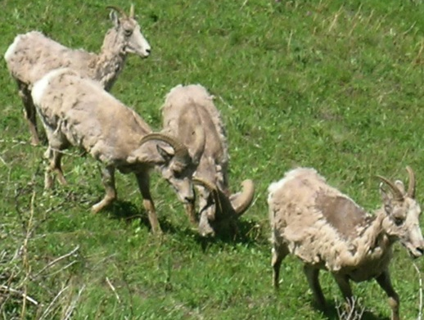

Slide 17
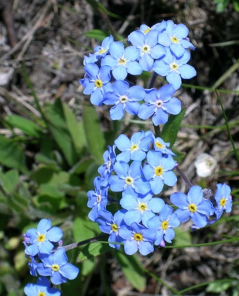
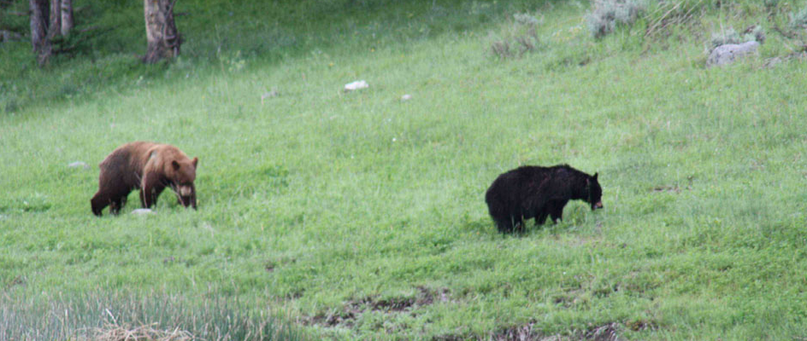

Slide 18
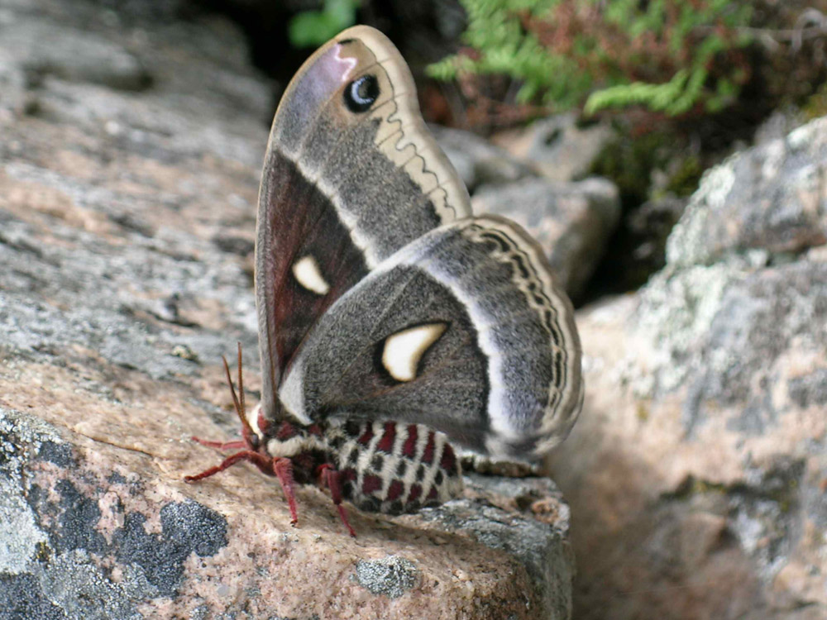
Yellowstone Wildlife!

Slide 19
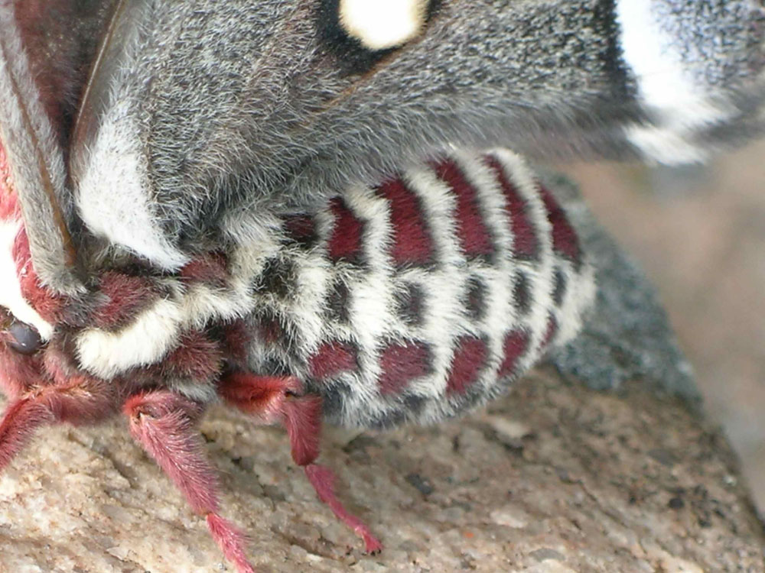
Yellowstone Wildlife!

Slide 20
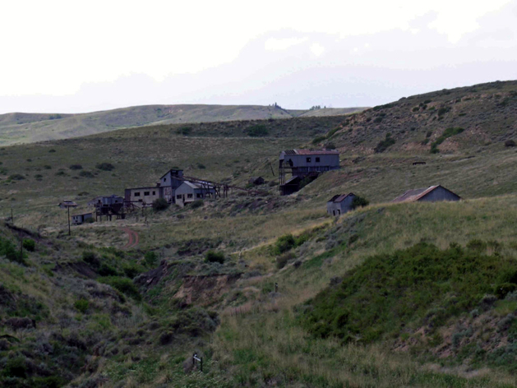
Public Policy
Many people in Wyoming make their living directly from the land: Ranching, oil, mining, tourism, hunting.
But, government controls a lot of the land: Should it be privatized? Would this let a more people make a living, or would it lead to unsustainable or undesirable land use?

Slide 21
Public Policy
Debate public policy while fly fishing (catching actual fish is optional) and yes, still more hiking.
Should this stream remain part of the U.S. Forest Service lands, or should it be sold to private individuals who could turn it into a money-making private resort? Should locals have more control over the land that surrounds them?

Slide 22
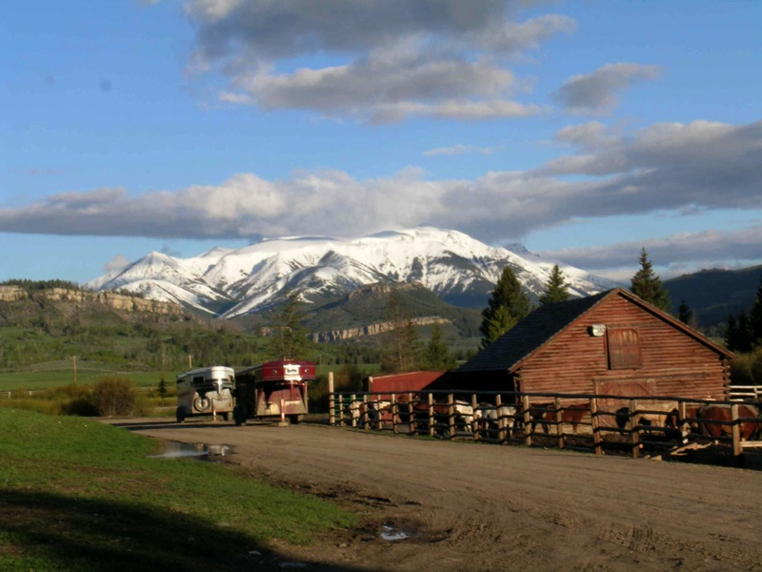
View from the K-Z Guest Ranch
And discuss public policy at the K-Z Ranch, owned and operated by nice folks with a long history in ranching.

Slide 23
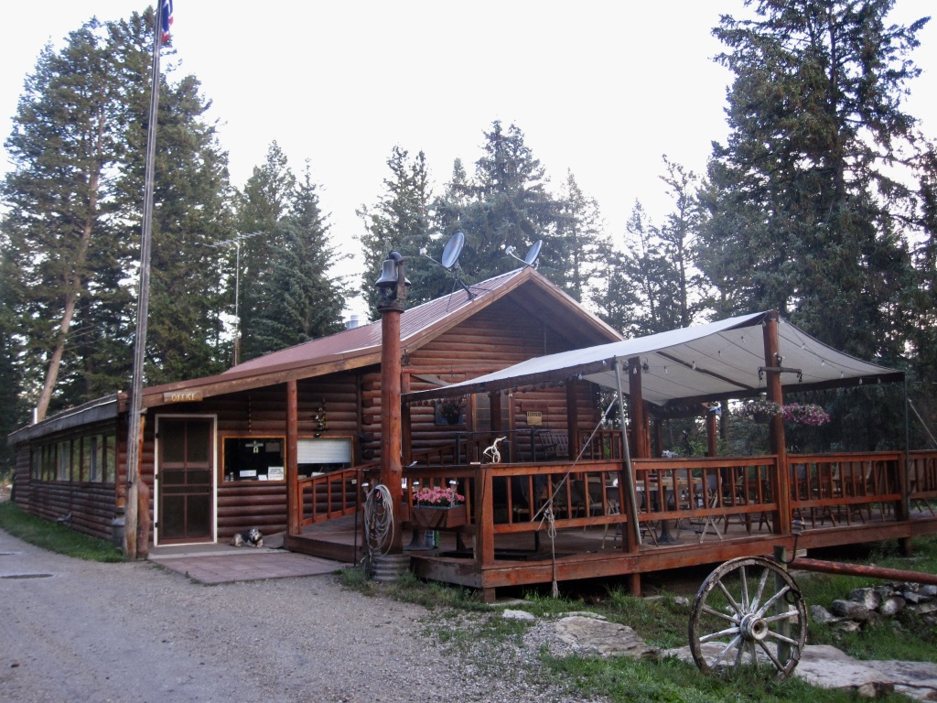
The K-Z Guest Ranch Lodge

Slide 24
GEOL 1930 Yellowstone Field Course
Fulfills the Environmental Studies field class requirement.
Elective for both Geology and Environmental Science.
Cost: About $4700, not including round-trip transportation.
Includes 4 credits (more credits would cost more)
Includes room and board, chauffeured transportation all around the area, all park fees, a professional rodeo in Cody, admittance to the four spectacular Buffalo Bill museums in Cody, and more.
The 2019 dates are from about June 11 to July 10 (4 weeks).
To sign up, just visit the Study Abroad Office (802 William Pitt Union) or www.abroad.pitt.edu/yellowstone.
Bill Harbert and Don Hopey are both at Pitt, and both teach the Yellowstone Field Class, and both are excellent people to talk to if you have more questions.

Slide 25
GEOL 1930 Yellowstone Field Class
vs. GEOL 1950 Wyoming Field Studies
Both classes feature a LOT of time spent out in nature. Both provide many opportunities to observe a diverse array of birds, mammals, and reptiles in the wild, as well a a host of plants in varied ecosystems.
The Wyoming Field Studies class is longer, and you live both in the prairie and near a mountain stream/woods, so I think you develop a more intimate connection with the landscapes of Wyoming in the Wyoming Field Studies class.
The Yellowstone Field Class has more of a humanities/public policy focus, whereas the Wyoming Field Studies class has more of a science focus and develops a range of hands-on field skills.
Neither has pre-requisites, so you should be able to excel at either one!

Slide 26
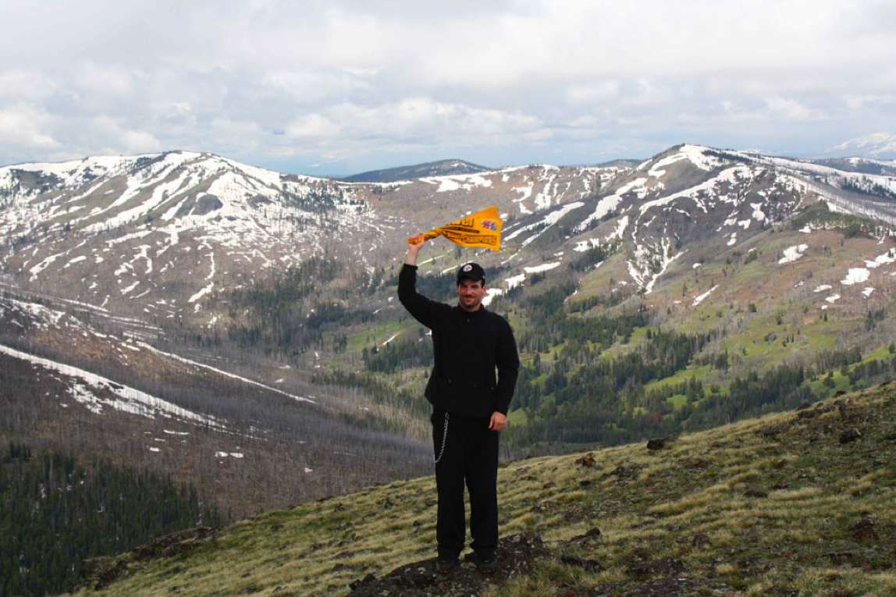
Wyoming: A Terrible Place

